Slide 1

WxMCTF
Let the hacking begin

Slide 2
What is WxMCTF?
Organized by two clubs at MGCI and WLMAC, WxMCTF is a beginner-level capture the flag (CTF) cybersecurity competition.
Battle it out with your CTF skills in digital forensics, website and binary exploitation, reverse engineering, and cryptography.

Slide 3
What is CTF?
In CTF, or capture the flag, a “flag” is hidden in a purposely vulnerable or tampered file or website.
Your mission: find the flag!
In WxMCTF, flags look like this:
wxmctf{thI$_is_@_fL@G}

Slide 4
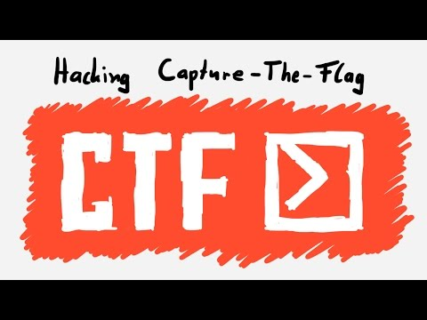
Still confused about what CTF is?
wxmctf{g0od_l^
Check out this video

Slide 5
Schedule
March 8th
19:00 EST
WxMCTF starts
March 10th
19:00 EST
WxMCTF Ends
Write-up contest starts
March 13th
23:59 EST
Write-up contest ends

Slide 6
Prizes
1st Place
$100 CAD
x4 .xyz domains
x4 Wolfram One Personal Edition
x4 Wolfram Alpha Pro
x4 1Password accounts
x4 Taskade upgrades
2nd Place
$50 CAD
x4 .xyz domains
x4 Wolfram One Personal Edition
x4 Wolfram Alpha Pro
x4 Taskade upgrade

Slide 7
Prizes
3rd Place
x4 .xyz domains
x4 Wolfram One Personal Edition
x4 Wolfram Alpha Pro
x4 Taskade upgrade
All Participants
7-day InterviewCake full coding interview prep course access pass
20% Taskade discount

Slide 8
Registration
Create an account here: https://ctf.mcpt.ca/accounts/signup/
To compete with up to 4 others, create or join a team
A comprehensive step-by-step tutorial is available here.

Slide 9
Scoring
Teams are ranked based on which teams gain the highest points. Ties will be broken by the first correct answer.

Slide 10



Sponsors
Axure RP is the only UX tool that gives UX professionals the power to build realistic, functional prototypes.
Generation XYZ combines Generations X, Y and Z to create a global community inspired by the Internet and its limitless potential. We're giving internet users – young and old, near and far - an innovative new platform to connect with the world in a whole new way.
No security groups. No egress fees. No quotas. No waiting. No hassle. Just GPUs. Powerful and cheap. Our marketplace approach to pricing ensures that you always have access to the best prices on the most powerful hardware while maintaining the flexibility to scale. Our deep relationships with suppliers provides peace of mind that your data is secure and your infrastructure reliable.

Slide 11



Sponsors
Interview Cake is a study tool that preps software engineering candidates for programming interviews.
Transform the way you work with Taskade, integrating task organization, project specifications, workflow automation, and team collaboration into one platform.
c3_3ve*y0n!}
Founded by Stephen Wolfram in 1987, Wolfram Research is one of the world’s most respected computer, web, and cloud software companies—as well as a powerhouse of scientific and technical innovation. As pioneers in computation and computational knowledge, we have pursued a long-term vision to develop the science, technology, and tools to make computation an ever-more-potent force in today’s and tomorrow’s world.

Slide 12

Sponsors
1Password makes it easy to generate, store, and autofill passwords for all your online accounts, on all your devices. Because weak and reused passwords are a leading cause of security incidents, using a password manager is an easy way to protect yourself, your family, or your business.

Slide 13
Ready to compete?
https://ctf.mcpt.ca/contest/wxmctf

Slide 14
Find more information here
Join our community Discord: https://discord.gg/pXX8Q8b4
Questions? Email wxmctf@gmail.com

Slide 15
Have fun
Hacking!

